Slide 1
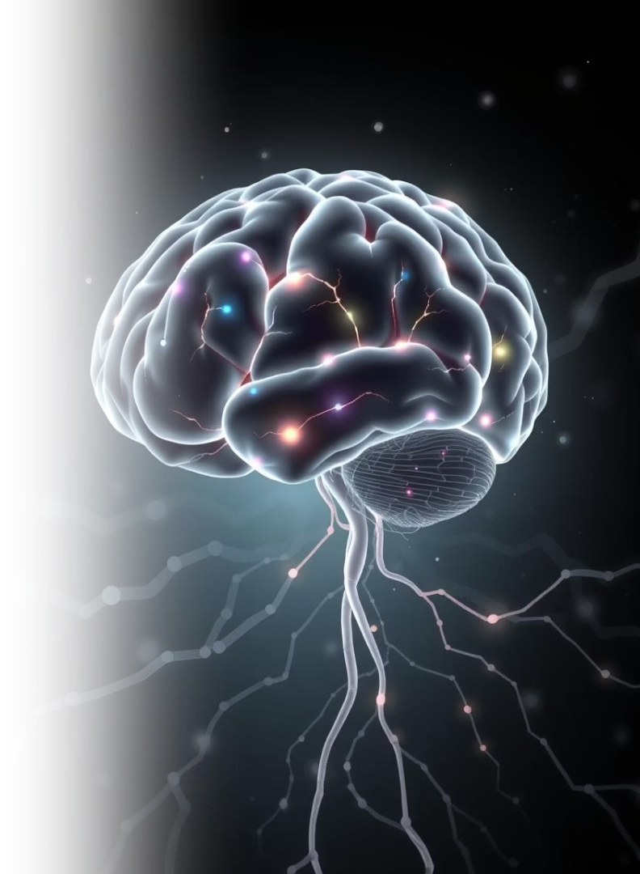
Project Title: NeuChromatic: Turn thoughts into chromatic experience
Course: Deep Learning and Reinforcement Learning
Team Members:
SHAMITHA BASAVARAJ - 1BG23CS138,
SINDHUJA C S - 1BG23CS151

Slide 2
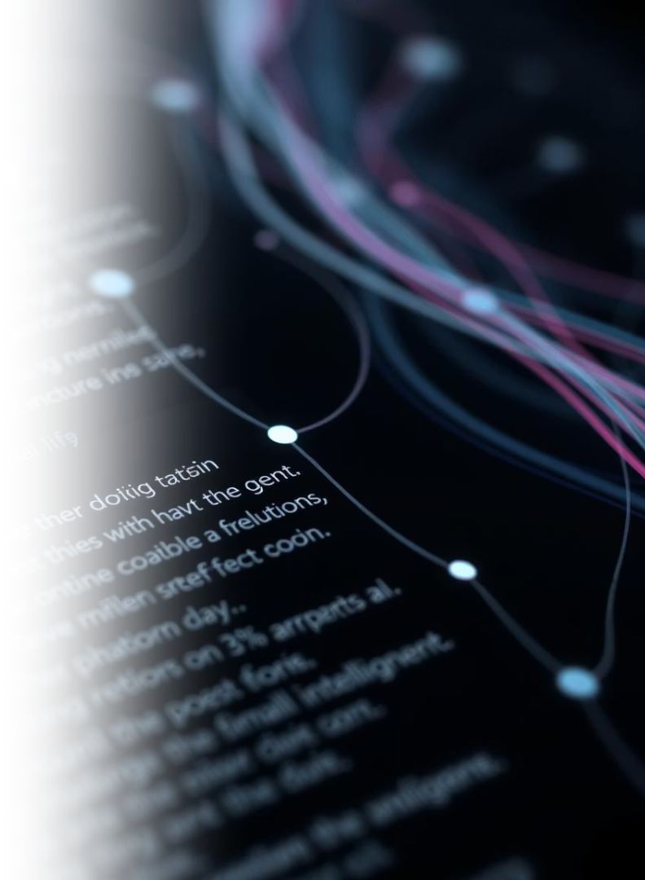




Project Objective: MindCanvas
Smart Journaling
Generate Visuals
Visualize Trends
Log and display mood changes.
Detect user emotions from text entries.
Create AI art based on mood.
Provide Feedback
Offer kind, AI-generated responses.

Slide 3
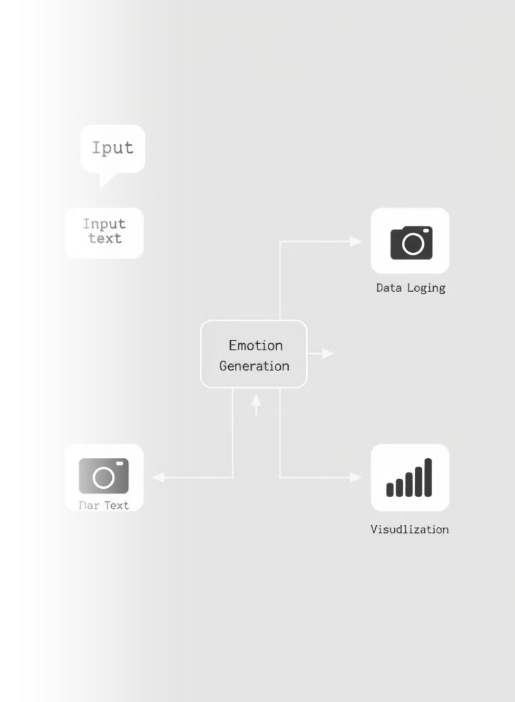




Methodology and Workflow
Emotion Detection
DistilBERT classifier.
Text Feedback
T5 (FLAN) model.
Visual Generation
Stable Diffusion prompts.
Trend Logging
CSV and Matplotlib.
The entire system was built and tested in Google Colab, leveraging its powerful GPU support for efficient processing of deep learning models.

Slide 4






Key Assumptions
Text Expressiveness
Input text adequately reflects user emotions.
Model Accuracy
Pretrained models perform well without fine-tuning.
User Consistency
Users maintain regular journaling habits.
Colab GPU
Sufficient GPU resources are available.

Slide 5
Model Evaluation and Analysis
Emotion Detection
Image Generation
Outputs include a label and confidence score.
Prompt-based results show variation.
Feedback Alignment
Mood Visualization
Contextually relevant to detected mood.
Graph tracks mental state shifts effectively.

Slide 6

Project Summary and Outcomes
Functional Pipeline
Real-time Generation
AI-driven journaling insights.
Sentiment to feedback and image.
Offline Logging
Reproducible Code
CSV-based data storage.
TensorFlow and HuggingFace.

Slide 7




Future Improvements and Extensions
Mood Forecasting
Implement regression for predictions.
Mobile App
Develop with offline support.
Daily Summaries
Integrate affirmations or summaries.
Biometric Input
Add emotion sensor integration.

Slide 8




Reflections and Learning Outcomes
Model Exploration
User-Centered AI
Transformers, diffusion models, sentiment.
Understanding of practical applications.
DL Limitations
Pipeline Integration
Discovered practical challenges and creative potential.
NLP, image generation, logging.
2
3
1
4

